Slide 1
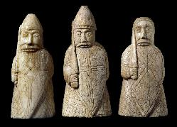
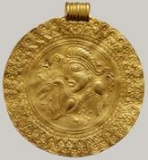
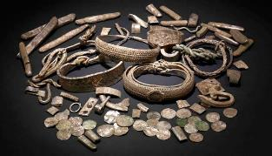
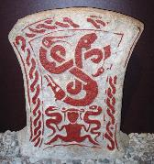
Project Andvari is an international collaborative project designed to create a free digital portal that will provide integrated access to collections of northern European art and artifacts of the early medieval period (4th–12th centuries).
Co-directors:
Lilla Kopár · The Catholic University of America
Nancy L. Wicker · The University of Mississippi
with the technical assistance of
Worthy N. Martin & Daniel Pitti
Institute for Advanced Technology in the Humanities, University of Virginia
andvari.iath.virginia.edu

Slide 2
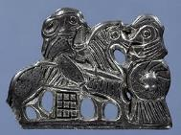
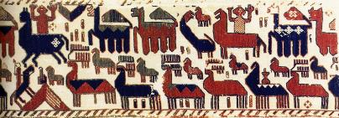
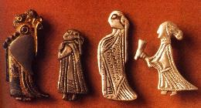
Challenges:
Dispersed information
Inconsistent terminology
Pre-conceived search options
Inaccessibility of new data
Need for collaboration
Harnessing public help
Solutions:
Integrated access to collections & databases
Standard keywords
Innovative search options
Augmented & enhanced data and metadata
Shared virtual workspace
Tiered access for researchers & the public

Slide 3
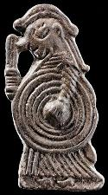
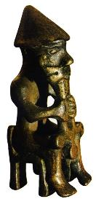
Plan of Action
Pilot Project developed in cooperation with IATH/UVA and participating museums and database owners.
The Launch of Andvari, a research tool that facilitates collaboration and the study of visual culture across media and beyond traditional geographical and disciplinary boundaries.
NEH-Funded International Workshop (November 8-9, 2013, Washington, DC) with participants from museums and research institutions in England, Germany, Norway, Scotland, Sweden, and the US.

