Slide 1
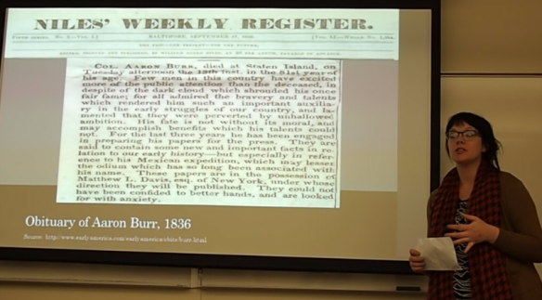
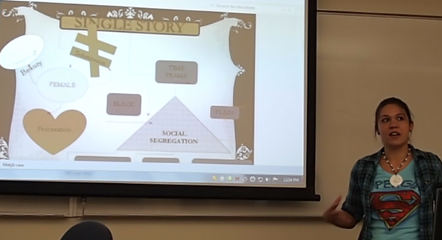
Bringing Digital Humanities to the Community College —and Vice Versa Project Director: Anne B. McGrail, Ph.D. Faculty, English, Lane Community College, Eugene, Oregon @annemcgrail on Twitter mcgraila@lanecc.edu Project Website: https://blogs.lanecc.edu/dhatthecc/
Develop a picture of the DH landscape in CCs
Cultivate an inclusive DH community of practice at community colleges in conversation with research-focused initiatives and institutions.
Bring DH to lower-division students and develop 21st century literacies in an open-access context.

Slide 2
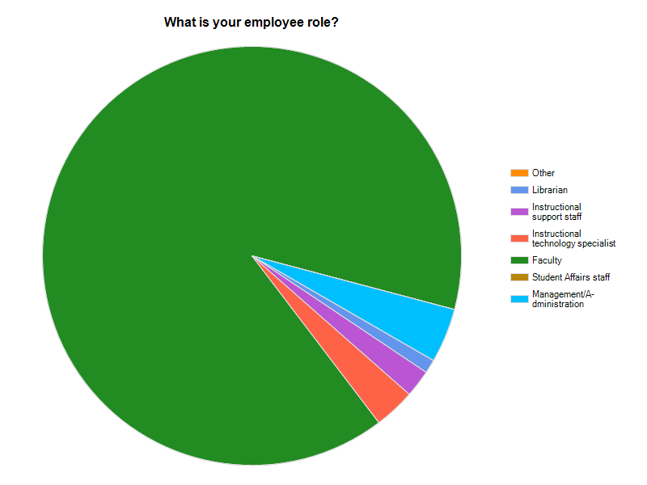
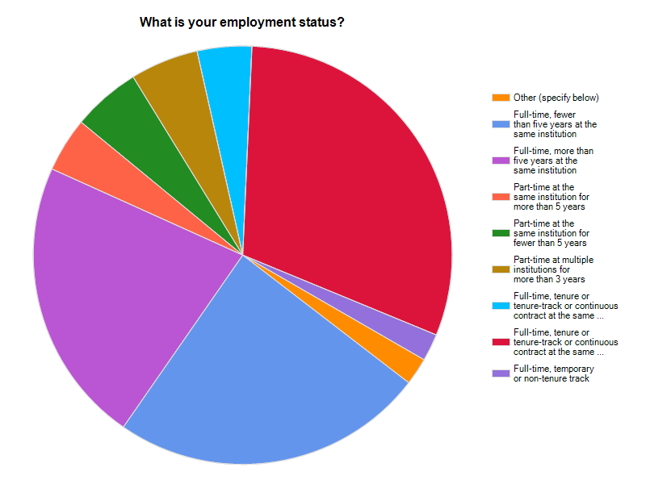
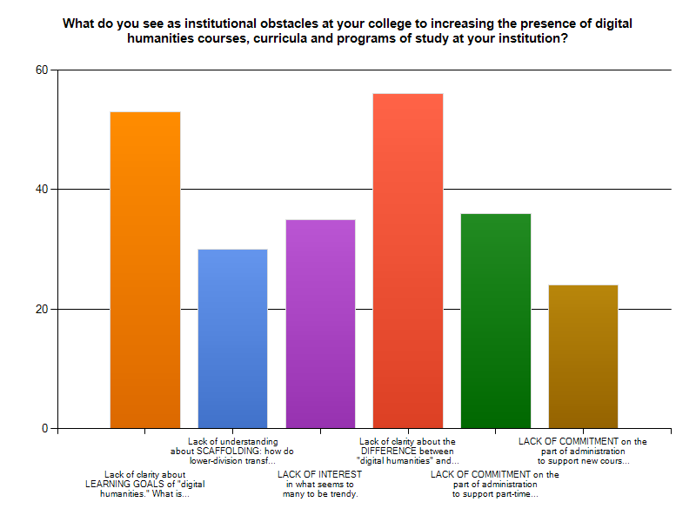
DH at CCs Now: A Snapshot National Survey of Digital Humanities in Community Colleges
27 Questions
Project Purpose
Roles and Part-Time/Full-Status
Digital Divide and Equity
Instructional Technology on Campus
Faculty Development
Institutional Issues
Familiarity with DH
SURVEY OPEN: Late September-October 2013
TARGETING AUDIENCE: CCHA, Listservs in Humanities, HASTAC , Twitter, Facebook, Faculty Assn. sites

Slide 3
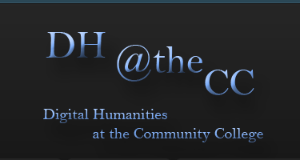
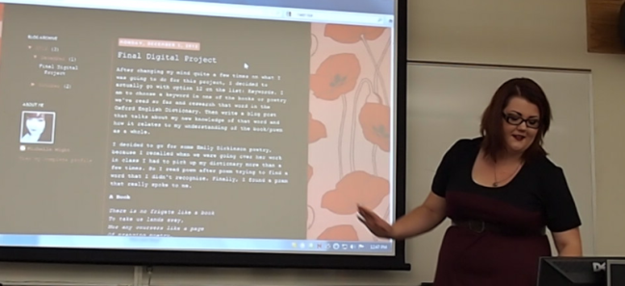
Interventions
Strategic Planning Workshop
CCHA National, October 24, 2013
A plan with next steps
Jake Agatucci, Editor, The Community College Humanist, creator of “Digital Games Culture”
Rebecca Frost Davis, Director of Instructional and Emerging Technology at St. Edward’s University
Matthew K. Gold, Associate Professor of English and Digital Humanities, City Tech and Graduate Center, CUNY
Anne McGrail, Project Director, DH at the CC
Dean Rheberger, Director of MATRIX at Michigan State
Jesse Stommel, Asst. Prof. Liberal Studies, Univ. of Wisconsin/Madison, co-founder of Hybrid Pedagogy
Terri Whitney, Professor of English at North Shore Community College and director of Hawthorne in Salem
Website and Wiki
Share lower-division humanities-focused assignments, pedagogies, problem-solving, best practices

