Slide 1
XQuery Summer Institute
June 9 to 20, 2014
Nashville, TN
<?xml version="1.0"?>
<contact>
<name role="director">Clifford Anderson</name>
<title>Director for Scholarly Communications</title>
<institution>Vanderbilt University</institution>
<address>131 21st Ave S Nashville, TN 37203</address>
<email>clifford.anderson@vanderbilt.edu</email>
<twitter>@andersoncliffb</twitter>
</contact>
Institute for Advanced Topics in the Digital Humanities
Sponsored by the Office of Digital Humanities (NEH)

Slide 2
A Language for Querying XML
xquery version "1.0"; for $contact in fn:doc("contact.xml")/contact let $email := $contact/email where $contact/name[@role = "director"] order by $email return <a href='mailto:{$email/text()}'> Join us! </a>
Flower macro by Doug Wheller
http://www.flickr.com/photos/doug88888/6093173748

Slide 3
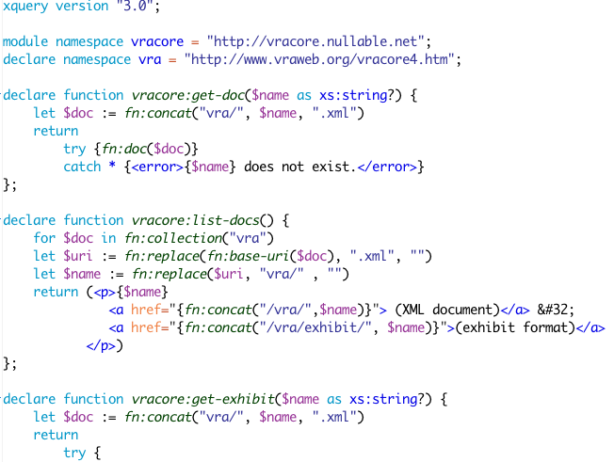
From Representation to Discovery
Old map By Photoshop Roadmap
http://www.flickr.com/photos/photoshoproadmap/7564212168/

